Slide 1
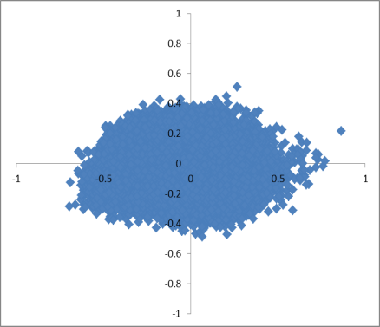
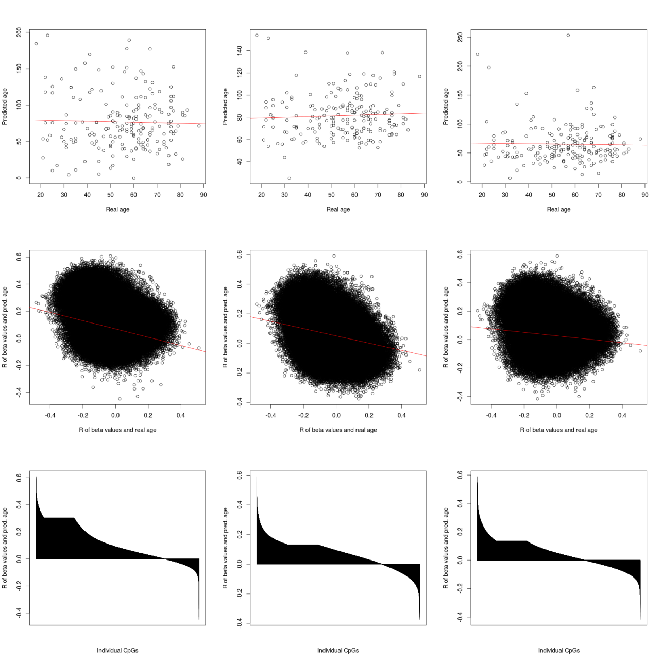
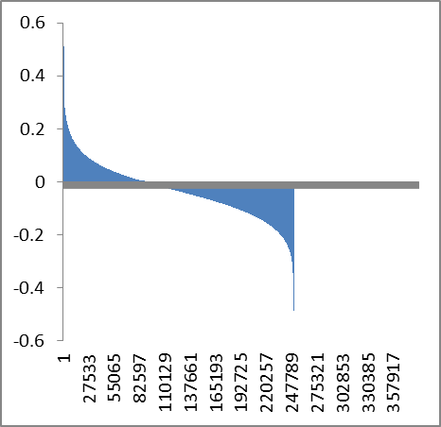
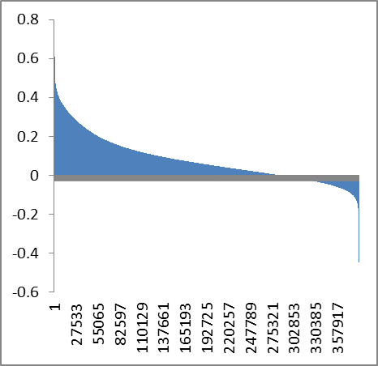
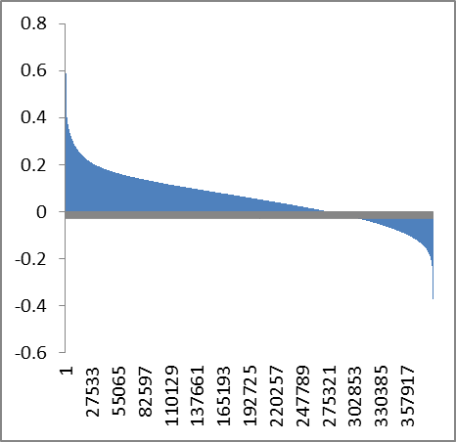
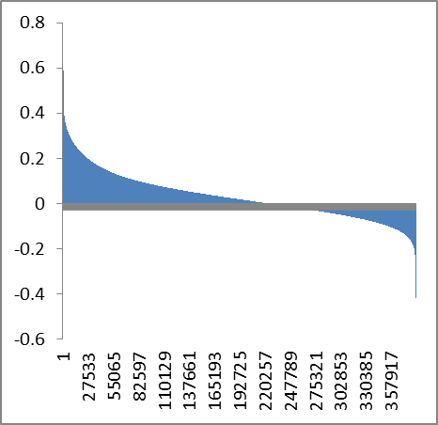
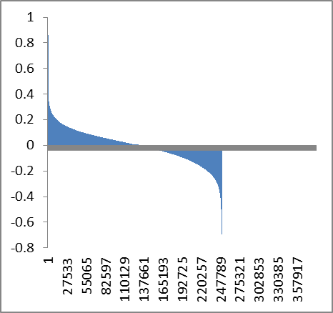
Correlation of DNAm with age
99 cpg
Hannum
Horvath
Perhaps we should also implement the same plot on the hammum data?
Correlation of real age in laml with beta-values
Age-correlation in laml
Age-correlation in normal blood (hannum)
Overlap of CpGs in the three orignical predictors (perhaps just as supplement)
Correlation of real age in hannum with beta-values
Perhaps we should also implement the same plot on the hammum data?

Slide 2
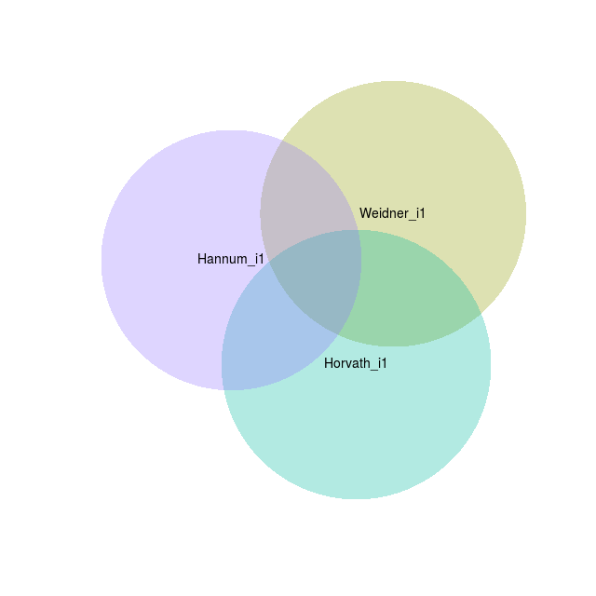
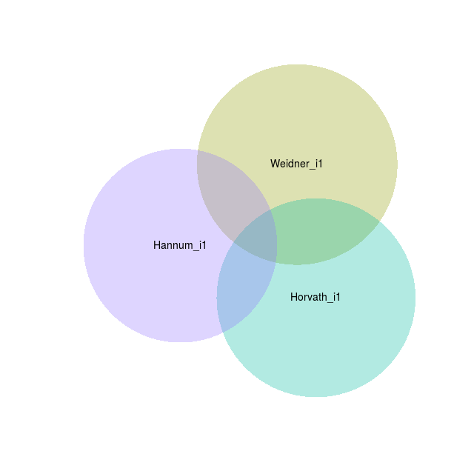
Top 500 positive correlation with predicted age
Top 500 negative correlation with predicted age
Top 500 abs correlation with predicted age
Perhaps we can test if there is convergence between the three different models if we only restrict to CpGs with variance >0.05….
Perhaps we can better understand on why e.g. the 99 CpG-AML-Signature does not perform well in iterations… and why the iterations of the individual models to not converge…. But perhaps we have to take it as given and use the alternative approach of the next figure….

Slide 3
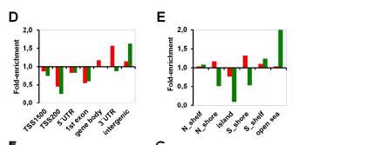
Variance filter >0.05
Correlation > 0.03
Only positive
Variance filter >0.05
Correlation > 0.03
Only negative
Variance filter >0.05
Correlation > 0.03
absolute
Color code for the three different age predictors
postive
Color code for the three different age predictors
negative
Gene Onthology (only absoulte) for each of the three age-predictors
Association with histone code?
Enrichment in chromosomal regions?
Enrichment in TF binding sites
Enrichment in miRNA binding sites???

Slide 4
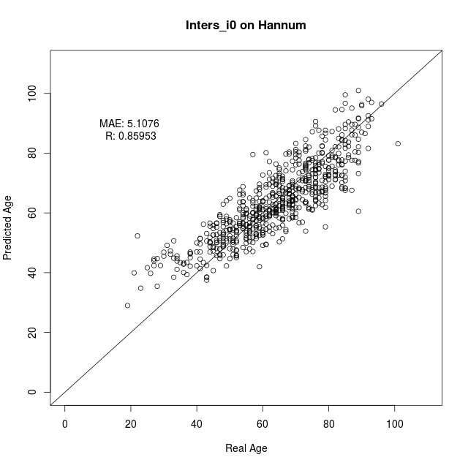
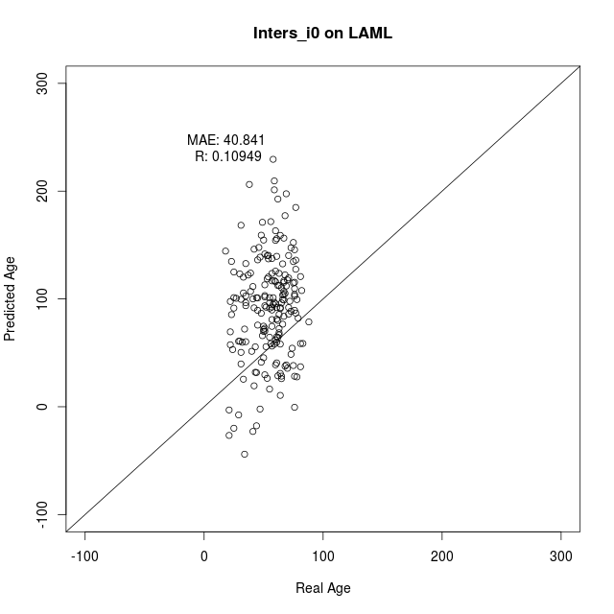
Variance filter >0.05
Correlation > 0.04
Only positive
99 CpGs in intersection of the three predictors – and all of them are exclusively positive.
These are used for retraining
… completely distinct from the Weidner 99 CpG model
Same figures as in Lin and Wagner Plos Genetics figure 2
And the survival
Validatio n in other AML datasets:
Karolinska,
AML Halle
AML-AZA
…another on that Tanja downloaded…
?? Test signature on other tumors? Similar to table 1 in Lin and Wagner PLoS Genetics…. If then we ask Qiong
?? Perhaps we can subclone and anlayze DNAm in individual clones?? Furthermore, we can ask Monika who has analyzed individual subclones in normal CD34+ cells…

